Slide 1
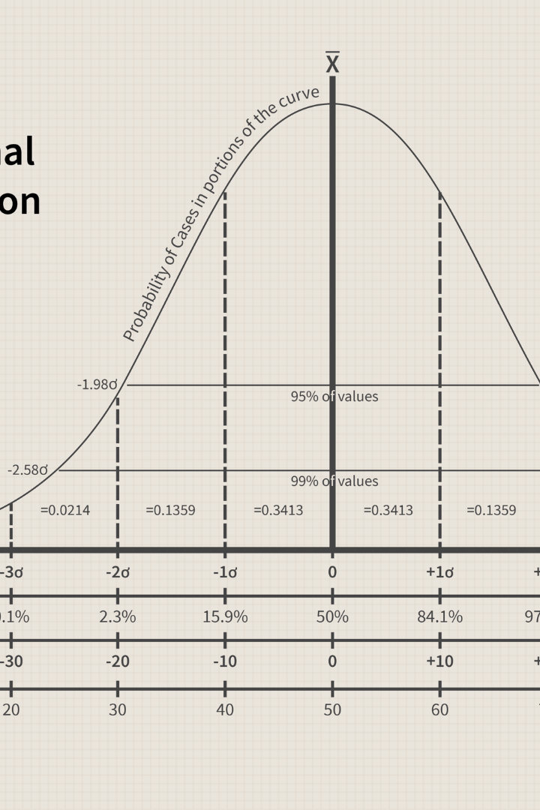

Kurtosis - Understanding the Measure of Data Distribution
Kurtosis is a statistical measure that helps us understand the shape and characteristics of a data distribution. Let's explore its definition, types, measures, interpretation, and applications.
by Raunit Sharma (23071A6754)

Slide 2

Definition of Kurtosis
Kurtosis quantifies the degree to which a distribution differs from the normal bell-shaped curve. It provides insights into the peakedness or flatness of a dataset.

Slide 3
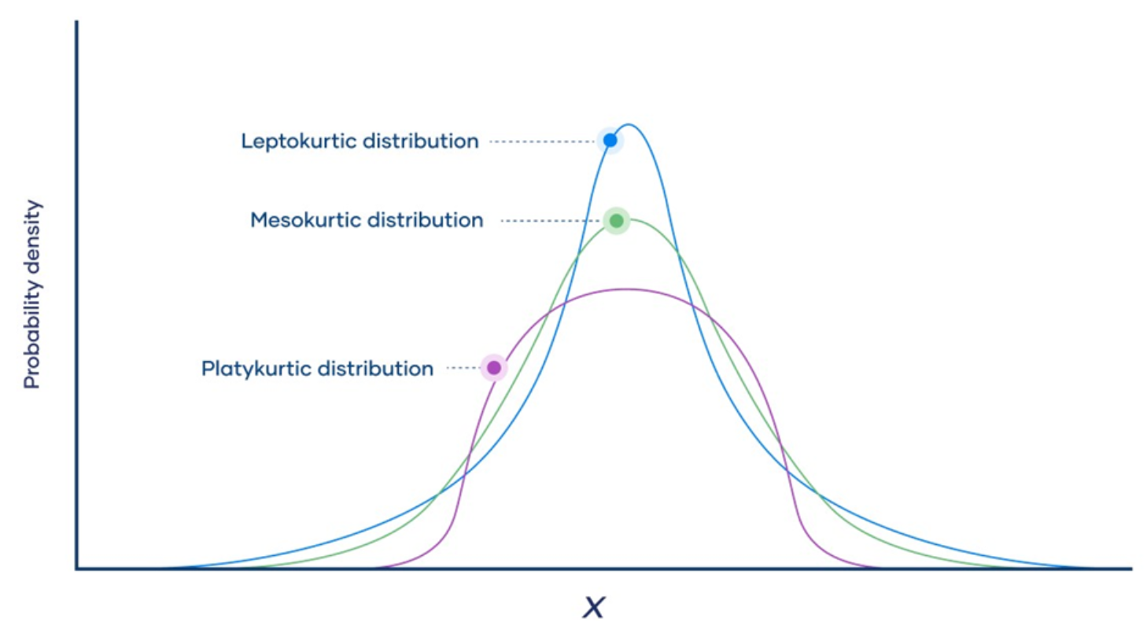


Slide 4

Types of Kurtosis
There are three main types of kurtosis:
1
Leptokurtic
A leptokurtic distribution has longer and fatter tails, indicating a higher concentration of data in the center. It is characterized by a high peak.
2
Mesokurtic
A mesokurtic distribution has a shape similar to a normal distribution, with moderate tails and a moderate peak.
3
Platykurtic
A platykurtic distribution has shorter and thinner tails, indicating a lower concentration of data in the center. It is characterized by a flatter peak.

Slide 5

Measures of Kurtosis
To quantify kurtosis, various measures are used:
Pearson's Kurtosis Coefficient
Fisher's Kurtosis Coefficient
Excess Kurtosis
This measure reveals the amount of kurtosis deviating from that of a normal distribution, where kurtosis is set to 0.
Pearson's coefficient compares the actual distribution with the normal distribution and calculates kurtosis based on fourth central moment.
Fisher's coefficient measures the kurtosis based on excess kurtosis, which subtracts 3 from the coefficient calculated using Pearson's method.

Slide 6

Interpretation of Kurtosis
The interpretation of kurtosis depends on its value:
1
Kurtosis > 0
A positive kurtosis indicates a distribution with heavier tails and a more peaked shape than a normal distribution.
2
Kurtosis < 0
A negative kurtosis suggests a distribution with lighter tails and a flatter shape than a normal distribution.
3
Kurtosis = 0
A kurtosis of 0 implies that the distribution has the same shape as a normal distribution.

Slide 7
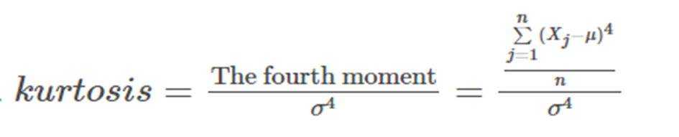
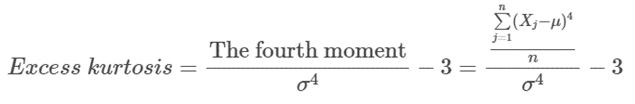
Mathematically, the kurtosis of a distribution of a random variable X, with a mean μ and standard deviation σ is defined as the ratio of the fourth moment to the square of the variance σ² .
From the above expression, we can already see that outliers will significantly impact this value.
This is because for any outlier xp , the value (Xp−μ) will tend to be large anyway, but then the outliers contribution to the sum is raised to the power of four i.e. (Xp−μ)⁴ . In other words, the key factor that would determine the value of kurtosis is the number and size of the outliers/extreme values, which are reflected in heavier/fatter tails of the distribution.

Slide 8

 | Category
 | Mesokurtic | Platykurtic | Leptokurtic
Tailedness | Medium-tailed | Thin-tailed | Fat-tailed
Outlier frequency | Medium | Low | High
Kurtosis | Moderate (3) | Low (< 3) | High (> 3)
Excess kurtosis | 0 | Negative | Positive
Example distribution | Normal | Uniform | Laplace

Slide 9
Applications of Kurtosis
Kurtosis finds applications in various fields:
Finance
Biostatistics
Kurtosis helps in analyzing the risk and volatility of financial assets.
Kurtosis assists in understanding the distribution of biological traits.
Data Analysis
Machine Learning
Kurtosis aids in identifying outliers and understanding the shape of datasets.
Kurtosis helps in feature selection and dimensionality reduction.

Slide 10
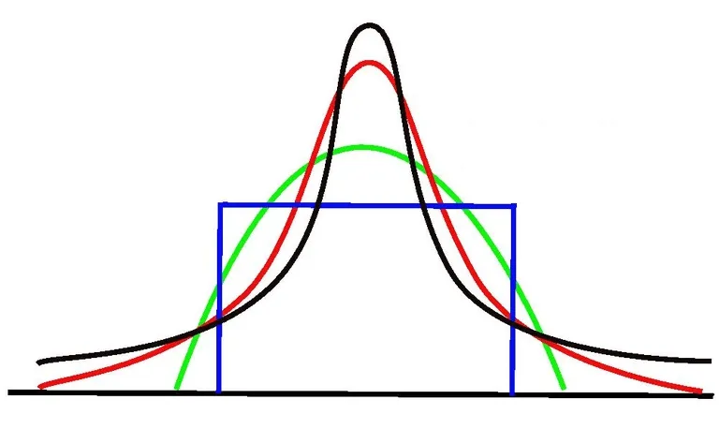
Applications of Kurtosis
Finance
In finance, kurtosis is used as a measure of financial risk. A large kurtosis is associated with a high risk for an investment because it indicates high probabilities of extremely large and extremely small returns. On the other hand, a small kurtosis signals a moderate level of risk because the probabilities of extreme returns are relatively low.

Slide 11
Conclusion
Kurtosis provides valuable insights into the shape of data distributions, allowing us to analyze and interpret various phenomena across different domains. It enables us to better understand the characteristics of our data and make informed decisions in our analytical endeavors.

